Slide 1
CHAPTER 10: Global Supply Chain

Slide 2
Global Economics
Globalization became a main business environment regardless of sizes of firms.
Drivers of globalization (Simchi-Levi et al. 2003)
Global cost forces – low wages, and supply advantages (parts and raw materials).
Global market forces – products and assets.
Technological forces – better access to technologies and management know-hows.
Risks of globalization
More demanding logistics operating environments
Security considerations
More complex total cost analyses

Slide 3
Global Economics
Table 10.1 Rational for globalization
Objective | Rationale
Increase revenue | Open up more markets Expand beyond competitors Obtain accessibility to markets that limit access without local operations
Achieve economies of scale | Take advantage of production capacity
Reduce direct cost | Take advantage of lower labor rates or real estate expense
Advance technology | Reduce energy requirements by reducing distance or changing transportation mode Take advantage of differences in production requirements Obtain access to advanced technology that may not be available from current locations due to historical investments Obtain access to specialized expertise or language skills

Slide 4
Global Economics
Table 10.1 Rational for globalization
Objective | Rationale
Reduce firm’s global tax liability | Obtain local or regional tax benefits related to property, inventory, or income Obtain reductions in value-added-taxes due to localized production or other value added services (i.e., packaging inventory management, customization)
Reduce market access uncertainty | Source product from location that involves less transportation uncertainty Source product from location that involved fewer security constraints
Enhance sustainability | Source products or other resources (including human resources) from locations that have ongoing availability of materials and expertise such as energy or trained workers

Slide 5
Global Supply Chain Integration
Global logistics must support operations in a variety of different national, political, and economic settings while also dealing with increased uncertainty associated with the distance, demand, diversity, and documentation of international commerce.
North America
A large geography with extensive and flexible transportation options
Europe
Numerous political, cultural, regulatory, and language situations
Pacific rim
Island-based environment with relatively poor infrastructure (extensive water and air shipments)
Firms require to develop and maintain a wide variety of logistics capabilities and expertise.

Slide 6
Global Supply Chain Integration
Logistics in global economy
Table 10-2 Estimated 2012 National logistics expenditures
Rep. of Korea
164,311 billion won (about 150 billion USD)
9.5% of GDP in 2017
Country/Region | Logistics as a Percent of Gross Domestic Product
United States | 8.5%
Japan | 11.0
Europe | 12.9
India | 12.9
Mexico | 14.0
China | 14.4
Asia | 16.8

Slide 7


Global Supply Chain Integration
Globalization Strategies
Four strategies: No international strategy, Multi-domestic strategy, Global strategy, Transactional strategy
No international strategy
No international businesses except for sourcing or delivery
Minimizes complexity and minimum coordination
Limited growth opportunity
Multi-domestic strategy (multi-national coperation-NMC)
Have separate headquarters (semi-autonomous headquarters) in different countries, thereby attaining more localized management.
A strategy by which companies try to achieve maximum local responsiveness by customizing both their product offering and marketing strategy to match different national conditions.
The firm can focus on local markets while minimizing overall coordination requirements.
Disadvantage - at the higher cost of forgoing the economies of scale from cost sharing and centralization.

Slide 8
Global Supply Chain Integration
Globalization Strategies
Global operation strategy
This strategy is the complete opposite of the multi-domestic strategy.
Cross-broader operations with some local market customization
A single headquarter coordinates global operations.
Logistics and supply chain activities occur globally.
Transactions between difference regions or countries are based on an arm’s length relationship.
Financial integration is common but product development, marketing, and supply chain, and planning are not common.
Advantages – ability to focus on multiple local markets, meeting the requirements of local customers, and ability to take advantage of global brands and products.
Disadvantages – difficulty of responding in an integrated manner to global customers and it is not scalable.
Examples: Microsoft, Procter & Gamble

Slide 9
Global Supply Chain Integration
Globalization Strategies
Transactional strategy
Uses a headquarter structure that optimizes effectiveness and performance.
Different operations are located at different regions
E.g. financial operations in EU or US, production or sourcing in Asia.
Firms have limited number of consolidated customer centers, limited number of production control centers, and limited number of purchasing centers.
A transnational product keeps its same characteristics, regardless of the country in which it is sold.
Advantages – utilizing economies of scale, and highly scalable for both domestic firms and global firms.
Disadvantages – substantial coordination and information integration are required and it reduces a firm’s ability to respond to individual market uniqueness.
Examples – ABB, Coca-Colar, Dow Chemical, etc.

Slide 10
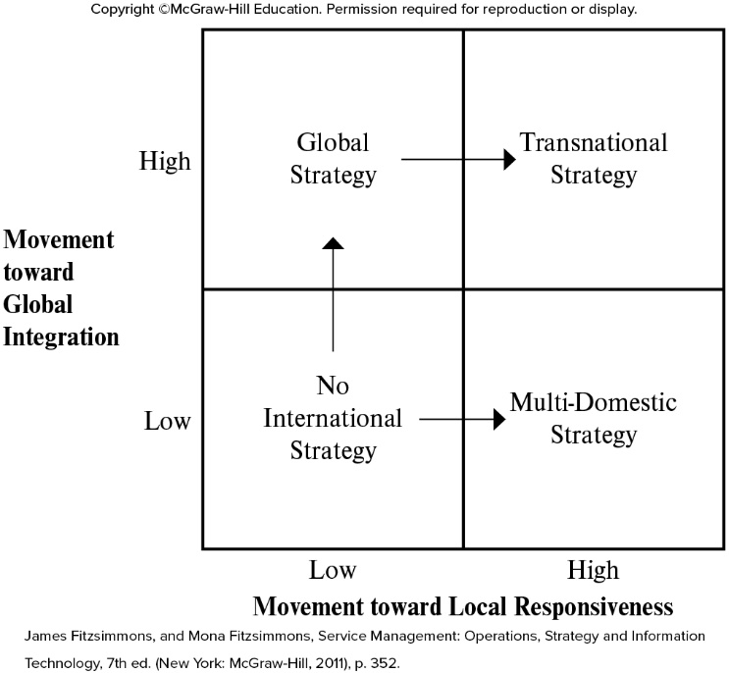
Global Supply Chain Integration
Globalization Strategies
Evolvement of no international strategy,
Figure 10.1 Generic international strategies

Slide 11
Global Supply Chain Integration
Globalization Strategies
Advantages and disadvantages of globalization strategies
Global Strategies | Advantages | Disadvantages
No international | Focused on local market Minimum coordination efforts Cross functional decisions made by small group of executive managers | Growth limited to local markets Not easy to respond to globally based customers Not large enough to take advantage of economies of scale
Multi-domestic | Focused on local market Minimum coordination efforts Allows firm to focus on key growth markets while minimizing complexity across a large number of markets. | Not scalable Not easy to respond to globally based customers
Global operations | Focused on local market Firm begins to take advantage of global brands and products Can meet the unique needs of individual markets | Not scalable Not easy to respond to globally based customers Limited synergies when working with global customers Limited drivers for global data and processes
Transactional | Global focus to facilitate global solution development and delivery Very scalable to domestic and global firms | Requires substantial coordination and information integration Reduced ability to respond to market uniqueness

Slide 12
Global Supply Chain Integration
Globalization Strategies
Comparison of global logistics and supply chain strategies with five factors
Service focus, marketing strategy, delivery strategy, management strategy, and human resource strategy
Development Stages | Service Focus | Marketing Strategy | Delivery Strategy | Management Strategy | Human Resource Development
No international strategy | Standard product for local market | Single strategy focused on local market | Direct to customer | Single simple financials | Operated by entrepreneur with limited specialization
Multi-domestic strategy | Domestic marketing and delivery | Domestic customers | Collaboration | Transaction driven with integrated financials | Management with “home country” focus
Global strategy | Local market customization | Focused specific market areas which may cross international boundaries | Subsidiaries with local presence | Decentralized operations with local profit responsibility | Limited top management with international experience
Transnational strategy | Global branding and integrated operations | Global customers | Worldwide flow of key resources | Centralized planning in global sites | International training and experience

Slide 13
Global Supply Chain Integration
Globalization Strategies
Global strategies and logistics decisions
Sourcing and resource choices are influenced by artificial constraints such as use restrictions, local content laws, or price surcharges.
Use restriction – limitation imposed by government (chemical materials)
Local content law – restriction to use resources within local economy.
Price surcharges – duties (import taxes) or tariffs (duty rates)
Logistics to support global operations increases planning complexity.
Higher uncertainty, infrastructure constraints, time differences, language differences, and government restrictions
Global operations extend domestic logistics systems and practices to a broad range of locations and operating environment.

Slide 14
Global Supply Chain Integration
Managing the global supply chain
Five differences between domestic and international operations.
Performance cycle structure, operational considerations, information system integration, and alliances
Performance cycle structure
Domestic – 1 to 5 days transportation and 2 to 10 days of total performance cycles
International – weeks to months of total performance cycles
Reasons of longer cycle time
Financing requirements, special packaging requirements, ocean freight scheduling, slow transit times, and customs clearance
Security issues can require extra delay.
Unbalance material moves – containers shortage from the US to Asia
Less consistent and flexible

Slide 15
Global Supply Chain Integration
Managing the global supply chain
Transportation
International shipments require multi-modal transportation.
Joint pricing and operating agreement are required.
Initially controlled by government but deregulated.
Influences of globalization to transportation industry
Intermodal ownership and operation
Deregulated intermodal ownership restrictions
Privatization
More flexible and efficient services available
Cabotage and bilateral agreements
Moving products and passengers between domestic ports
Deregulated the usage restrictions
Infrastructure constraints
Significantly increased demands result in substantial congestions

Slide 16
Global Supply Chain Integration
Managing the global supply chain
Operational considerations
Requires multiple Languages for both product and documentation
Multi-lingual documentation and postponement are used to reduce inventory requirements.
E.g. Minimizing the use of language for products (Apple and IKEA)
Unique national accommodations
Performance features – product functionalities (e.g. speed or process constraints)
Technical characteristics – power supply and documentation
Environmental considerations - chemicals
Safety requirements – automatic shutoffs and specialized documentation
Sheer amount of documentation required
Order contents, transportation, financing, and government control
Table 10.4

Slide 17
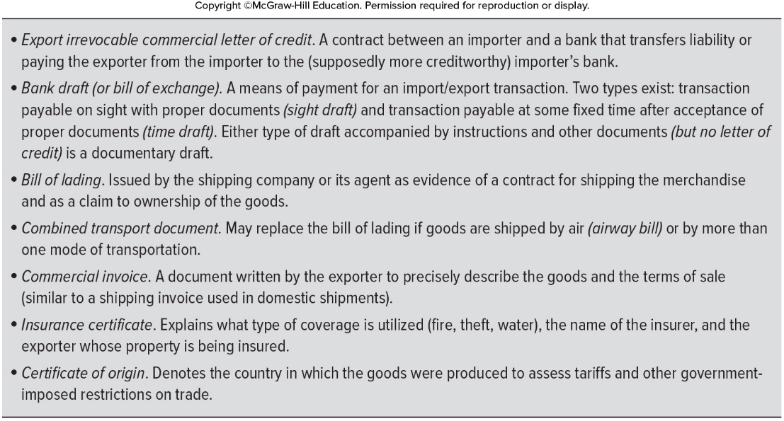
Global Supply Chain Integration
Managing the global supply chain
Operational considerations
Sheer amount of documentation required (cont)

Slide 18
Global Supply Chain Integration
Managing the global supply chain
Operational considerations (cont)
High incidence of countertrade (product return) and duty drawback (return) found in some international situations.
Countertrade – upon agreement
Duty drawback – when products return it should be processed.
Information system integration
Integration of information system across different countries required
Global transaction or ERP integration
Global planning system that is used for maximizing resource utilization
Third-party alliances
Alliances with carriers and special service providers are essential for global logistics
Provides market access and expertise
Reduces inherent global risks

Slide 19
Global Sourcing
Rational for international sourcing from low-cost countries
Reducing manufacturing cost (low labor cost) results in increasing logistics cost
Reducing sourcing cost (low cost suppliers) results in increasing competitive pressure on domestic suppliers.
Reducing sourcing cost (low cost suppliers) results in increasing the domestic supplier’s exposure (investment) to state-of-art product and process technologies.
Without a pressure from suppliers of low cost countries, domestic suppliers will not invest new technologies due to significant assets tied up in older technologies.
Sourcing is to establish a local presence to facilitate sales in the international country.
Notes:
Rational means here objective facts.

Slide 20
Global Sourcing
Challenges for low-cost-country sourcing
Global sourcing has been extensively implemented in developed countries. But there are many issues and challenges that are further complicated by benefits and costs to different organizational units.
First, identification of qualified and capable sources
Ability to meet volume and seasonal fluctuating demands
Second, protection of firm’s intellectual property
Need to have legal constraints to protect product design and trading secrets
Third, understanding import/export compliance issues
Volume of commodities are enforced.
Percentage of foreign-sourced materials are restricted.

Slide 21
Global Sourcing
Challenges for low-cost-country sourcing (cont)
Fourth, communication with suppliers and transportation companies
Negotiations with suppliers, logistics suppliers, and government
Due to time zone, language, and technology differences
Fifth, security of the product during transportation
Containers and vehicles
Sixth, inventory and obsolescence risk over extended transit time
Lots of variables during one or two months of transit time
Higher inventory carrying cost and obsolescence cost
Higher risk on quality problems
Seventh, need to understand the difference between piece price and total cost
Piece cost – direct and indirect cost
Total cost – freight, inventory, obsolescence, duties, taxes, recovery, and other considerations

Slide 22
Global Sourcing
Guideline for sourcing
Products or components should be source domestically
parts or products with short life cycle.
high variations in product mix
Precise forecasts of product mix might be difficult.
high intellectual property content should be sourced domestically.
Low-cost labor contents should be sourced globally.
high transportation cost
Products with bulky or easily damaged
high value
products constrained by security or other type of import restrictions.
high degree of transport uncertainty with low volume

Slide 23
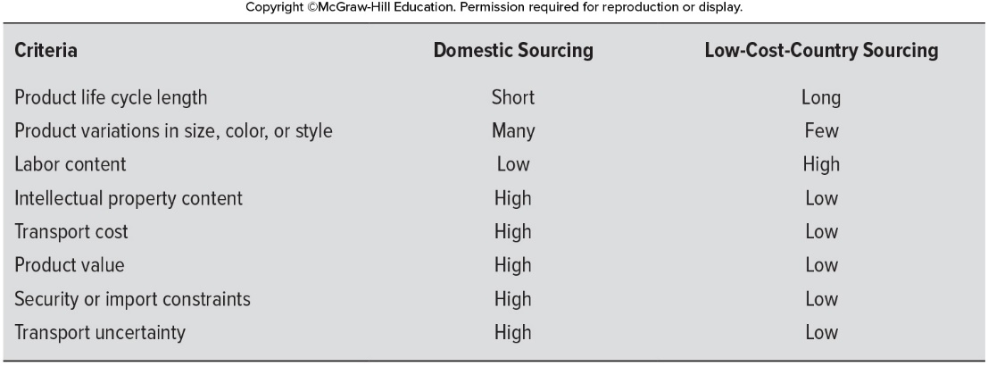
Global Sourcing
Guideline for sourcing (cont)
Table 10.5 Sourcing guidelines
Final determination depends on the specific item and the firm’s expertise.
Logistic supports might be a key for successful global sourcing
Longer distances, demand differentials, and cultural diversity, and complex documentation

Slide 24
Global Sourcing
Global comparison of supply chain characteristics
Infrastructure
Transportation rights-of-way, human capital, political environments, and technical infrastructure
Technology
Capabilities of the communications, power, and production facilities
Human capital
Training, skill level, and wage scale of labor
Political environment
Stability of the legal environment, trade agreements, intellectual property, and anti-corruption laws

Slide 25
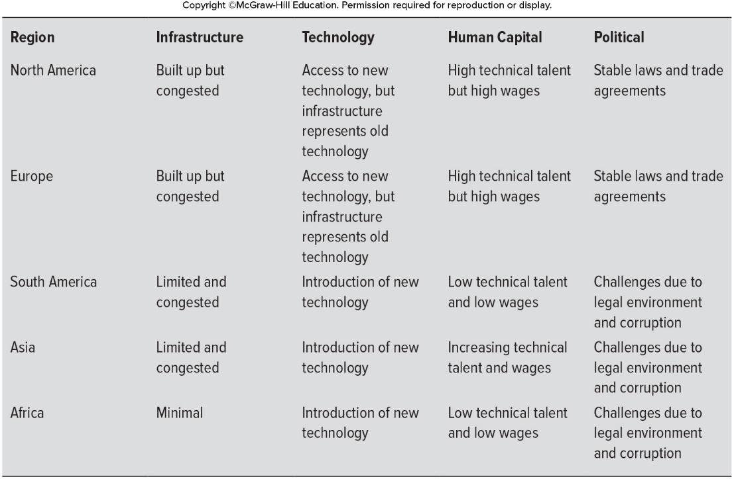
Global Sourcing
Global comparison of supply chain characteristics

Slide 26
Global Sourcing
Modes of entry
Four approaches (modes) for globalization
Exporting and importing
A firm sells its products either to an international firm for remarketing or to a firm local in the target country.
Licensing and franchising
Franchising in a target country
International joint venture
Foreign direct ownership (investment)
Table 10. 7 the characteristics, strengths, and weaknesses for each entry mode

Slide 27
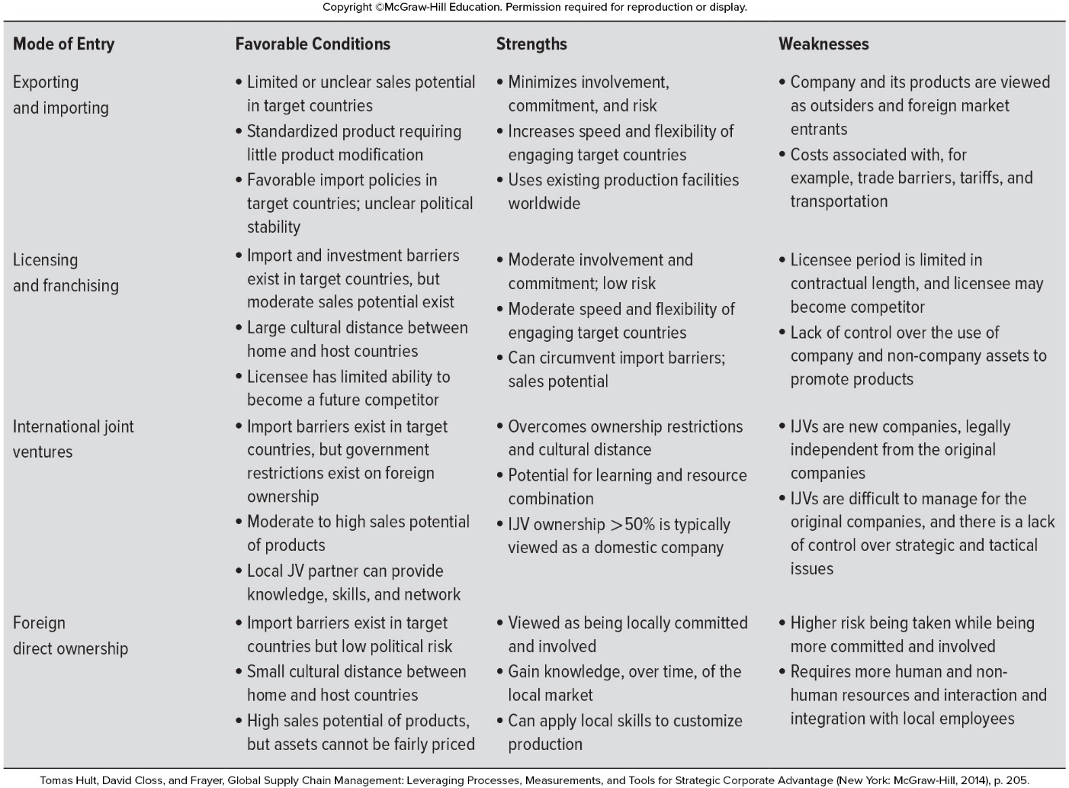

Slide 28
Global Compliance
Type of compliance regulations, role of customs brokers, and penalties for not following custom regulations
Customs and border protection (CBP)
The agency (government organization) of US responsible for import law, and duty and tariff collection.
KCS (Korea Customs Service)
Investigating all individuals and products brought into the country to meet requirements
Monitoring cross-border movement for drugs, illicit materials, and weapons.
Duties and taxes are advalorem (based on product value)

Slide 29
Global Compliance
Custom compliance
The requirements to enforce government regulations regarding import/export materials, and duties and tariffs.
Three main activities required by firms
Classification of products
Duty rates based on product classification
Failure results in fines and penalties
Accurate records regarding export/import
Used for aggregating imports/exports for the overall economy and trade levels with various counties.
Monitoring the destination, end user or end use is appropriate.
Homeland security protection purposes
Customer broker
Specially trained individual or firm for paper works of imports/exports
Acing as a firm’s liaison with CBP on admissibility, coordination of cargo exams, and post-entry action (advisor only)

Slide 30
Global Compliance
Enforcement
Many enforcement regulations if broken
Minor violations
late filings – fine
Major violations
Misclassification of goods and valuation errors, errors in recordkeeping
Negligence
Fails to exercise a reasonable care
Gross negligence
Wanton disregard of the law or relevant facts
Fraud penalties
Intent to deceive or mislead
Enforce compliance
Detaining shipments, deny entry, seize the goods, move the goods to a bonded or foreign trade zone warehouse and begin forfeiture proceedings, or criminal proceeding

Slide 31
Study Objectives
Explain the rational for globalization.
Explain about the four strategies of globalization including their advantages and disadvantages.
Explain how the no globalization strategy can be evolved into other globalization strategies.
Explain the five differences between domestic and international operations.
Explain about the rational and challenges for low-cost-country sourcing.
Explain the guideline for sourcing decisions.
Explain about the four approaches (modes) for globalization.
Explain about the compliances of globalization.

